Slide 1

WEKA, Mahout, and MLlib Overview
Sagar Samtani, Weifeng Li, and Hsinchun Chen, with updates from Shuo Yu
Spring 2019, MIS 496A
Acknowledgements: Mark Grimes, Gavin Zhang – University of Arizona
Ian H. Witten – University of Waikato
Gary Weiss – Fordham University

Slide 2
Outline
WEKA introduction
WEKA capabilities and functionalities
Data pre-processing in WEKA
WEKA Classification Example
WEKA Linear Regression Example
WEKA Conclusion and Resources
Appendix A – WEKA Classification and Clustering features
Appendix B – WEKA Clustering Example
Appendix C – WEKA integration with Java
Big Data Mining: Mahout/MLlib

Slide 3
WEKA Introduction
Waikato Environment for Knowledge Analysis (WEKA), is a Java based open-source data mining tool developed by the University of Waikato.
WEKA is widely used in research, education, and industry.
WEKA can be run on Windows, Linux, and Mac.
Download from http://www.cs.waikato.ac.nz/ml/weka/downloading.html
Download WEKA 3.8.3 (stable version)
In recent years, WEKA has also been implemented in Big Data technologies such as Hadoop.

Slide 4
WEKA’s Role in the Big Picture
Input
Raw data
Data Mining by WEKA
Pre-processing
Classification
Regression
Clustering
Association Rules
Visualization
Output
Result

Slide 5
WEKA Capabilities and Functionalities
WEKA has tools for various data mining tasks, summarized in Table 1.
A complete list of WEKA features is provided in Appendix A.
Data Mining Task | Description | Examples
Data Pre-Processing | Preparing a dataset for analysis | Discretizing, Nominal to Binary
Classification | Given a labeled set of observations, learn to predict labels for new observations | BayesNet, KNN, Decision Tree, Neural Networks, Perceptron, SVM
Regression | Learn to predict numeric values for observations | Linear Regression, Isotonic Regression
Clustering | Identify groups (i.e., clusters) of similar observations | K-Means
Association rule mining | Discovering relationships between variables | Apriori Algorithm, Predictive Accuracy
Feature Selection | Find attributes of observations important for prediction | Cfs Subset Evaluation, InfoGain
Visualization | Visually represent data mining results | Cluster assignments, ROC curves
Table 1. WEKA tools for various data mining tasks

Slide 6
WEKA Capabilities and Functionalities
WEKA can be operated in four modes:
Explorer – GUI, very popular interface for batch data processing; tab based interface to algorithms.
Knowledge flow – GUI where users lay out and connect widgets representing WEKA components. Allows incremental processing of data.
Experimenter – GUI allowing large scale comparison of predictive performances of learning algorithms
Command Line Interface (CLI) – allowing users to access WEKA functionality through an OS shell. Allows incremental processing of data.
WEKA can also be called externally by programming languages (e.g., Matlab, R, Python, Java), or other programs (e.g., RapidMiner, SAS).

Slide 7
Data Pre-Processing in WEKA – Data Format
The most popular data input format for Weka is an “arff” file, with “arff” being the extension name of your input data file. Figure 1 illustrates an arff file.
Weka can also read from CSV files and databases.
@relation heart-disease-simplified
@attribute age numeric
@attribute sex {female, male}
@attribute chest_pain_type {typ_angina, asympt, non_anginal, atyp_angina}
@attribute cholesterol numeric
@attribute exercise_induced_angina {no, yes}
@attribute class {present, not_present}
@data
63, male, typ_angina, 233, no, not_present
67, male, asympt, 286, yes, present
67, female, ?, ?, ?, present
Name of relation
Data types for each attribute:
Nominal – followed by brackets enumerating possible values
Numeric – integers or floating numbers
Each row of data, comma separated,
a single question mark (?) if unknown

Slide 8
Data Pre-Processing in WEKA
We will walk through sample classification and clustering using both the Explorer and Knowledge Flow WEKA configurations.
We will use the Iris “toy” dataset. This data set has five attributes (Petal Width, Petal Length, Sepal Width, Sepal Length, and Species), and contains 150 data points.
The Iris datasets can be downloaded from the class website in Topic 1, item 23:
Download the training set (iris-train.arff, used for model training)
Download the test set (iris-test.arff, data we want to predict)

Slide 9
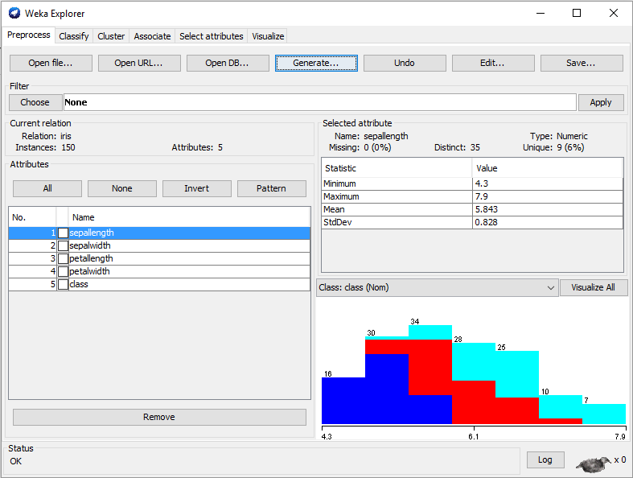
Data Pre-Processing in WEKA - Explorer
To load the Iris data into WEKA Explorer view, click on “Open File” and select the Iris-train.arff file.
After loading the file, you can see basic statistics about various attributes.
You can also perform other data pre-processing such as data type conversion or discretization by using the “Choose” tab.
Leave everything as default for now.
1
3
2

Slide 10
CLASSIFICATION EXAMPLES
DECISION TREE (C4.5)
RANDOM FOREST
NAIVE BAYES

Slide 11
WEKA Classification – Classification Examples
Let’s use the loaded data to perform classification tasks.
In the Iris dataset, we can classify each record into one of three classes - setosa, versicolor, and virginica.
The following slides will walk you through how to train various models (Decision Tree (C4.5), Random Forest, and Naïve Bayes), compare their performances, and use the best model on a set of unseen data.

Slide 12
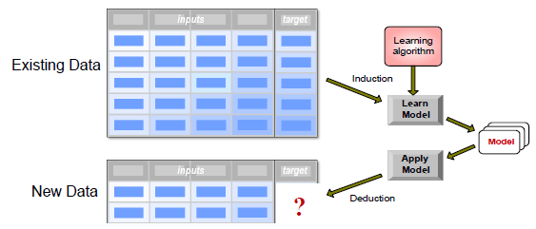
WEKA Classification
First, recall that the classification process uses a training set to train a model to predict unseen data.
In our case we train, evaluate, and apply a classifier to classify flowers into their appropriate species.
Decision tree
Random Forest
Naïve Bayes
…
Iris-train.arff
Iris-test.arff

Slide 13
WEKA Classification – Decision Tree Example
A decision tree is a tree-structured plan of a set of attributes to test in order to predict the output.
There are many algorithms to build a Decision Tree (ID3, C4.5, CART, SLIQ, SPRINT, etc).
Since the Iris dataset contains continuous attributes, we will utilize C4.5 as the primary algorithm.
Represented as J48 in WEKA.

Slide 14
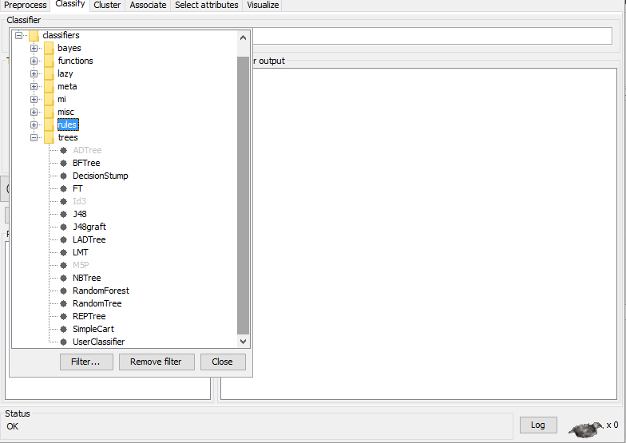
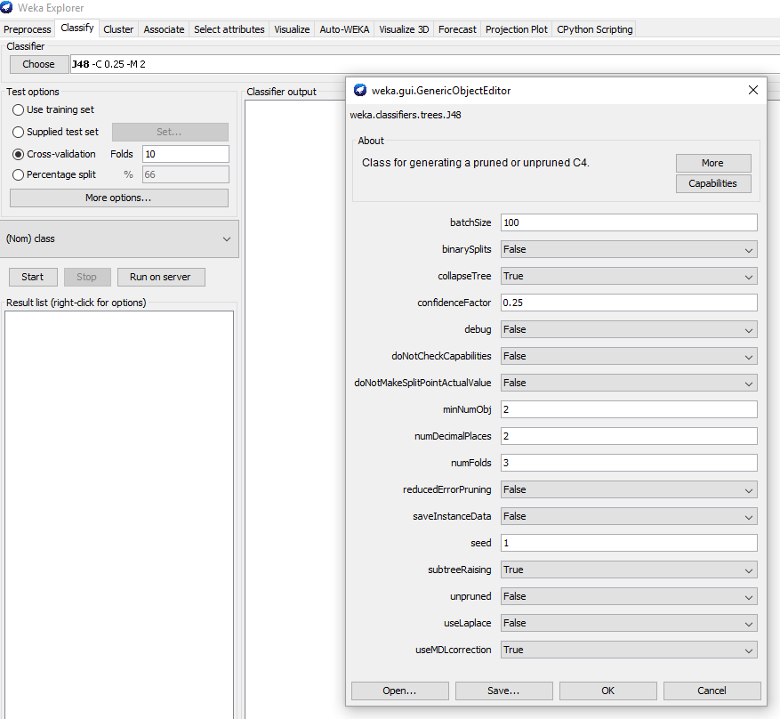
Decision Tree Training – Explorer Configurations
1
1
1
2
List of all
classifiers
3
2
After loading data, select the “Classify” tab. All classification tasks will be completed in this area.
Click on the “Choose” button. WEKA has a variety of in-built classifiers. For our purposes, select “J48.” You can use ID3 if you prefer.
You can configure the classifier accordingly. For now, you can leave all settings as default.
WEKA also allows you to select testing/training options. 10 fold cross-validation is a standard, select that.
After configuring the classifier settings, press “Start.”

Slide 15
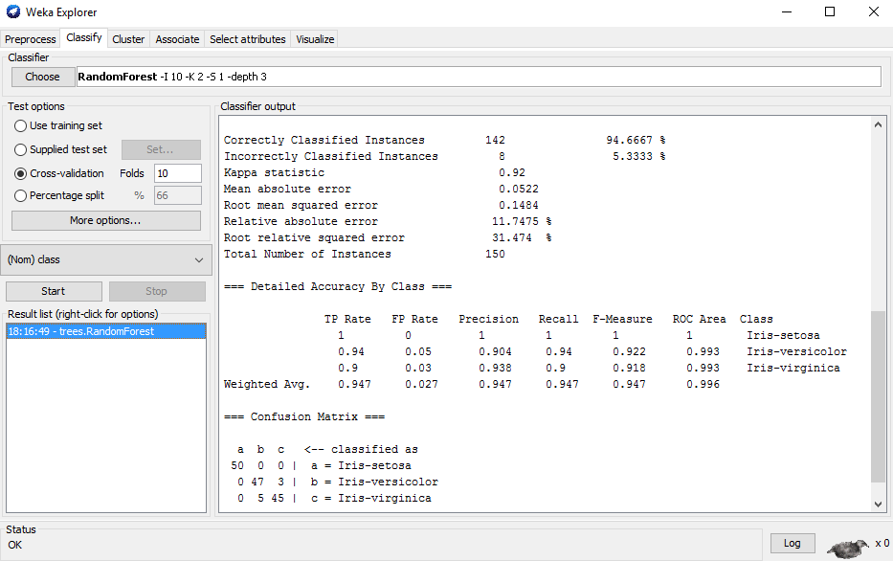
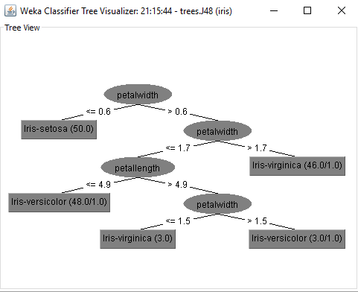
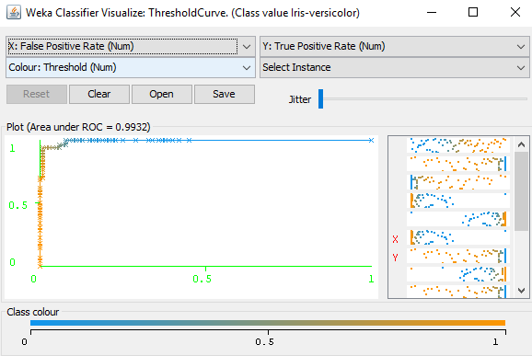
Decision Tree Training – Explorer Results
3
1
2
3
After running the algorithm, you will get your model results! All of the previously run models will appear in the bottom left.
The results of your classifier (e.g., confusion matrix, accuracies, etc.) will appear in the “Classifier output” section.
You can also output results as a CSV for later processing.
You can also generate visualizations for your results by right-clicking on the model in the bottom left and selecting a visualization.
Actual decision tree and and ROC curve visualizations are provided on the right.

Slide 16
WEKA Classification – Random Forest Example
Random Forest is based off of bagging decision trees.
Each decision tree in the bag is only using a subset of features.
As such, there are only a few hyper-parameters we need to tune in WEKA:
How many trees to build (we will build 10)
How deep to build the trees (we will select 3)
Number of features which should be used for each tree (we will choose 2)

Slide 17
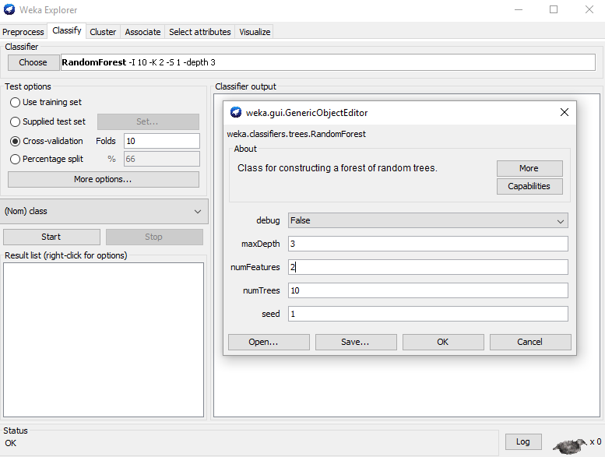
Random Forest Training – Explorer Configurations
1
1
2
1
List of all
classifiers
3
2
Let’s configure the classifier to have 10 trees, a max depth of 3, each tree to use 2 features.
WEKA also allows you to select testing/training options. 10 fold cross-validation is a standard, select that.
After configuring the classifier settings, press “Start.”
After loading data, select the “Classify” tab. All classification tasks will be completed in this area.
Click on the “Choose” button. WEKA has a variety of in-built classifiers. For our purposes, select “Random Forest.”

Slide 18
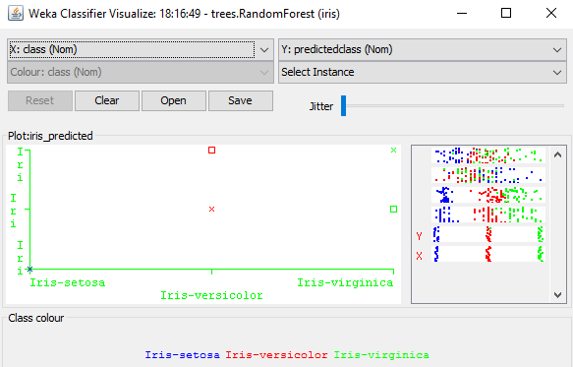
Random Forest Training – Explorer Results
3
1
2
3
After running the algorithm, you will get your results! All of the previously run models will appear in the bottom left.
The results of your classifier (e.g., confusion matrix, accuracies, etc.) will appear in the “Classifier output” section.
You can also generate visualizations for your results by right-clicking on the model in the bottom left and selecting a visualization.
Classifier errors and ROC curve visualizations are provided on the right.

Slide 19
WEKA Classification – Naïve Bayes Example
Naïve Bayes is a probabilistic classifier using Bayes’ theorem.
Assumes that the value of features are independent of other features and that features have equal importance.
Hence “Naïve”
WEKA supports various Bayes classifiers including Naïve Bayes and Multinomial Naïve Bayes.
We will use regular Naïve Bayes.

Slide 20
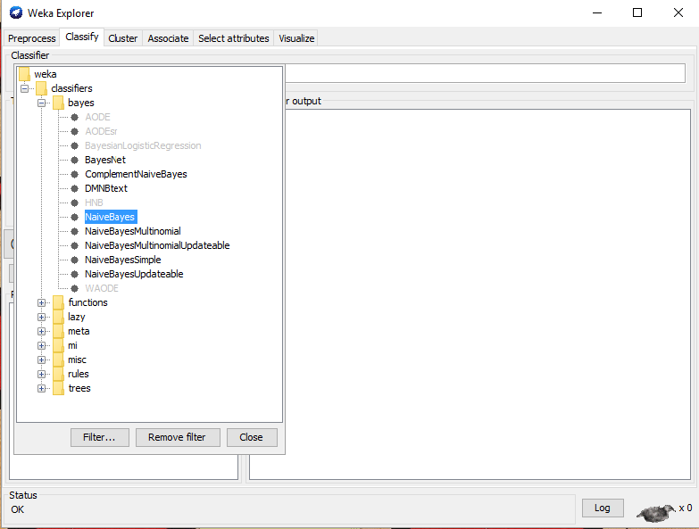
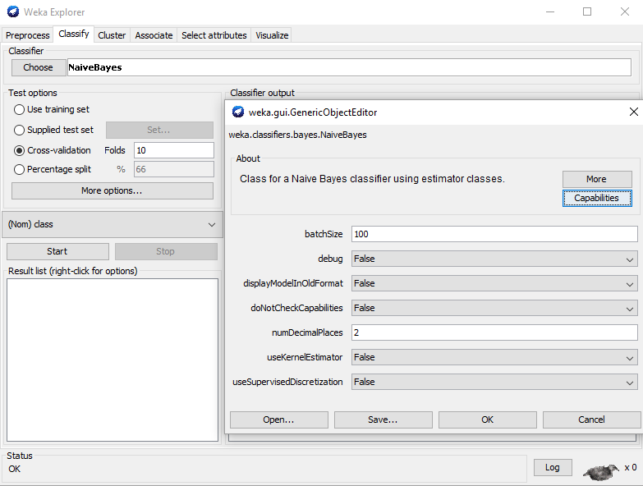
Naïve Bayes – Explorer Configurations
1
1
2
1
2
3
List of all
classifiers
Naïve Bayes in WEKA does not need much model configuration. You can leave everything as is.
WEKA also allows you to select testing/training options. 10 fold cross-validation is a standard, select that.
After configuring the classifier settings, press “Start.”
You will get results similar to previous screenshots.
After loading data, select the “Classify” tab. All classification tasks will be completed in this area.
Click on the “Choose” button. WEKA has a variety of in-built classifiers. For our purposes, select “Naïve Bayes.”

Slide 21
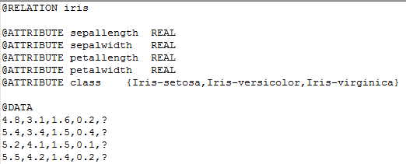
Applying the Trained Model
Now that you have trained three different models, you can select a model to apply to unseen data.
The trained model will apply what it has learned to identify the species of a flower based on its features.
The iris-test.arff file contains records which are going to predict.
Description
of data
Classes data will
be predicted into
Actual Data
Question marks designate
unknown classes
(e.g., what we want to predict)

Slide 22
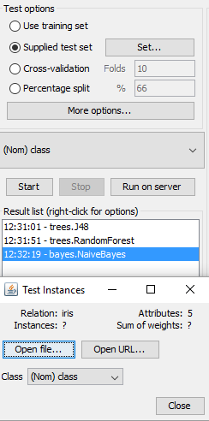
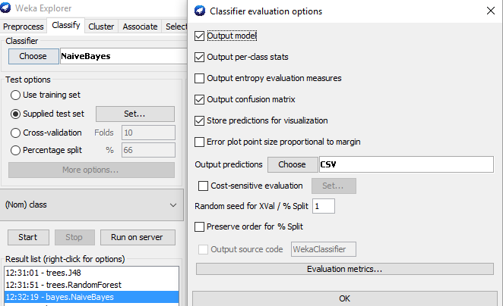
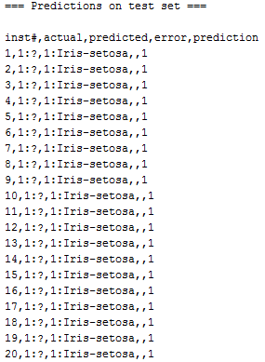
Applying Trained Model and Outputting Results
1
2
3
1
2
1
3
First, select “Supplied test set” for a given model (Naïve Bayes), and point it to the iris-test.arff file.
Second, select “More options…” and change “Output predictions” to CSV. This will output the prediction results in a CSV format in the console.
Third, press “Start.” This will classify all of the records. The output will show up in a CSV format in the console. You can then use the results in further analysis tasks.

Slide 23
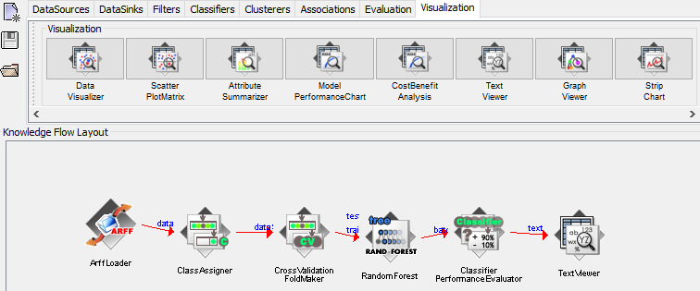
WEKA Classification – Knowledge Flow
We can also run the same classification task using WEKA’s Knowledge Flow GUI.
Select the “ArffLoader” from the “Data Sources” tab. Right click on it and load in the Iris arff file.
Then choose the “ClassAssigner” from “Evaluation” tab. This icon will allow us to select which class is to be predicted.
Then select the “Cross Validation Fold Maker” from the “Evaluation” tab. This will make the 10 fold cross- validation for us.
We can then choose a classifier from the “Classifiers” tab.
To evaluate the performance of the classifier, select the “Classifier Performance Evaluator” from the “Evaluation” tab.
Finally, to output the results, select the “Text Viewer” from the “Visualization” tab. You can then right click on the Text Viewer and run the classifier.
1
2
3
4
5
6
7

Slide 24
REGRESSION EXAMPLE – LINEAR REGRESSION

Slide 25
WEKA Regression – Linear Regression Example
Recall that regression is a predictive analytics technique predicting the specific value for a given data record, rather than a discrete class.
E.g., the NFL trying to predict the number of Super Bowl viewers
In this example, we will use linear regression to predict the selling price on a home based its house size, lot size, # of bedrooms/bathrooms.
Please download the houses-train.arff and houses-test.arff files from the class website. Load in the houses-train.arff file into WEKA.

Slide 26
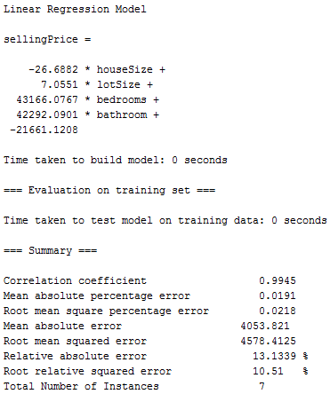
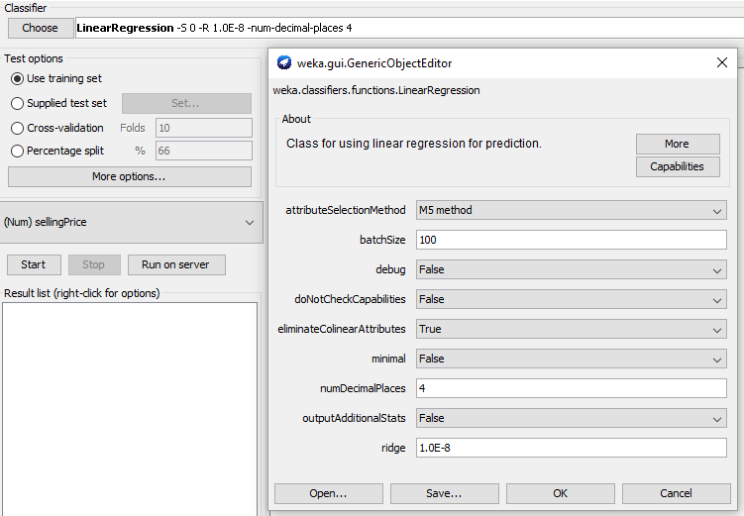
Linear Regression Training – Explorer Configurations
1
1
3
2
3
After loading in the dataset, press “Choose” and select “Linear Regression” from the functions category. Configure the settings accordingly.
Second, select “Use training set.” This will create a linear regression model for the loaded data.
Third, press “Start.” This will now create a model and provide a summary of the overall model (e.g., correlation coefficient, mean absolute error, etc.).

Slide 27
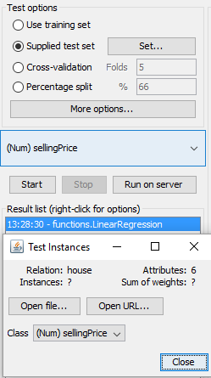
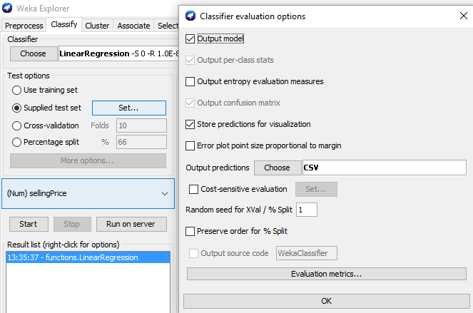
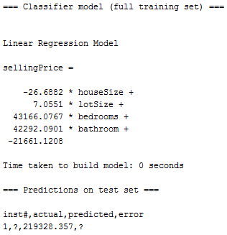
Linear Regression Application – Explorer Results
1
3
2
2
1
3
After training the model, we will apply it to an unseen data point to predict its selling price. Choose the “Supplied test set” option and point it to the houses-test.arff file.
Select “More options…” and click on output predictions to CSV.
Finally, press “Start.” This will run the model, and the actual predicted value for the data point will be displayed in CSV format.

Slide 28
Conclusion and Resources
The overall goal of WEKA is to provide tools for developing Machine Learning techniques and allow people to apply them to real-world data mining problems.
Detailed documentation about different functions provided by WEKA can be found on the WEKA website and MOOC course.
WEKA Download – http://www.cs.waikato.ac.nz/ml/weka/
MOOC Course – https://weka.waikato.ac.nz/explorer

Slide 29
Appendix A – WEKA Pre-Processing Features
Learning type | Attribute/ Instance? | Function/Feature
Supervised | Attribute | Add classification, Attribute selection, Class order, discretize, Nominal to Binary
 | Instance | Resample, SMOTE, Spread Subsample, Stratified Remove Folds
Unsupervised | Attribute | Add, Add Cluster, Add Expression, Add ID, Add Noise, Add Values, Center, Change Date Format, Class Assigner, Copy, Discretize, First Order, Interquartile Range, Kernel Filter, Make Indicator, Math Expression, Merge two values, Nominal to binary, Nominal to string, Normalize, Numeric Cleaner, Numeric to binary, Numeric to nominal, Numeric transform, Obfuscate, Partitioned Multi Filter, PKI Discretize, Principal Components, Propositional to multi instance, Random projection, Random subset, RELAGGS, Remove, Remove Type, Remove useless, Reorder, Replace missing values, Standardize, String to nominal, String to word vector, Swap values, Time series delta, Time series translate, Wavelet
 | Instance | Non Sparse to sparse, Normalize, Randomize, Remove folds, Remove frequent values, Remove misclassified, Remove percentage, Remove range, Remove with values, Resample, Reservoir sample, Sparse to non sparse, Subset by expression

Slide 30
Appendix A – WEKA Classification Features
Classifier Type | Classifiers
Bayes | BayesNet, Naïve Bayes, Naïve Bayes Multinomial, Naïve Bayes Multinomial Updatable, Naïve Bayes Updateable
Functions | Gaussian Processes, Linear Regression, Logistic Regression, Multilayer Perceptron, SGD, SDG Text, Simple Linear Regression, Simple Logistic Regression, SMO, SMOreg, Voted Perceptron
Lazy | IBk, Kstar, LWL
Meta | AdaBoostM1, Additive Regression, Attribute Selected Classifier, Bagging, Classification via Regression, Cost Sensitive Classifier, CV Parameter Selection, Filtered Classifier, Iterative Classifier Optimizer, Logit Boost, Multiclass Classifier, Multiclass Classifier Updateable, Multischeme, Random Committee, Randomizable Filtered Classifier, Random Subspace, Regression by Discretization, Stacking, Vote, Weighted Instances Handler Wrapper
Misc | Input Mapped Classifier, Serialized Classifier
Rules | Decision Table, Jrip, M5 Rules, OneR, PART, ZeroR
Trees | Decision Stump, Hoeffding Tree, J48, LMT, M5P, Random Forest, Random Tree, REP Tree

Slide 31
Appendix A – WEKA Clustering Features
Cobweb, DBSCAN, EM, Farthest First, Filtered Clusterer, Hierarchical Clusterer, Make Density Based Clusterer, OPTICS, SimpleKMeans

Slide 32
Appendix B – WEKA Clustering
Clustering is an unsupervised algorithm allowing users to partition data into meaningful subclasses (clusters).
We will walk through an example using the Iris dataset and the popular k-Means algorithm.
We will create 3 clusters of data and look at their visual representations.

Slide 33
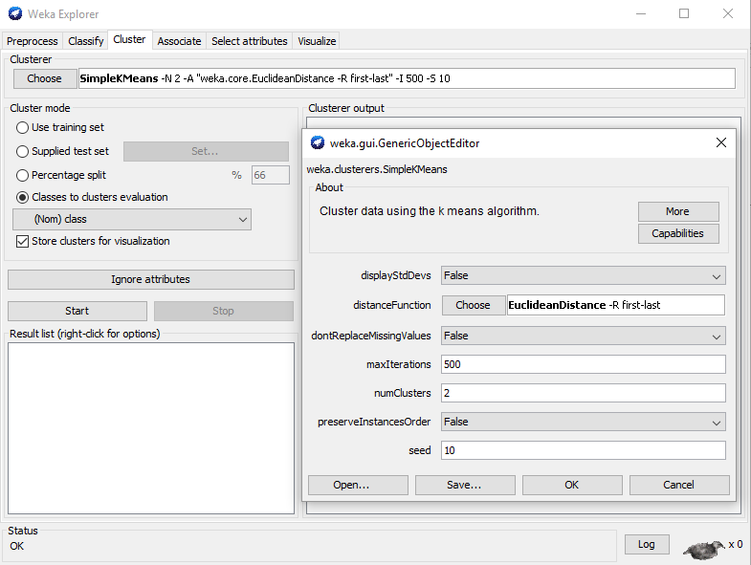
Appendix B – WEKA Clustering: Explorer Configuration
Performing a clustering task is a similar process in WEKA’s Explorer. After loading the data, select the “Cluster” tab and “Choose” a clustering algorithm. We will select the popular k-means.
Second, configure the algorithm by clicking on the text next to the “Choose” button. A pop up will appear allowing us to choose select the number of clusters we want. We will choose 2, as that will create 3 clusters. Leave others default.
Finally, we can choose a cluster mode. For the time being, we will select “Classes to clusters evaluation.”
After configuration, press “Start”
1
3
2

Slide 34
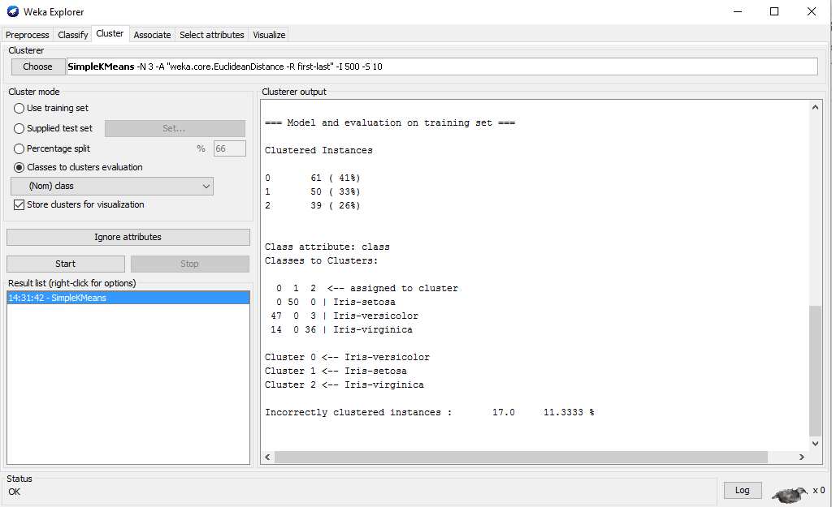
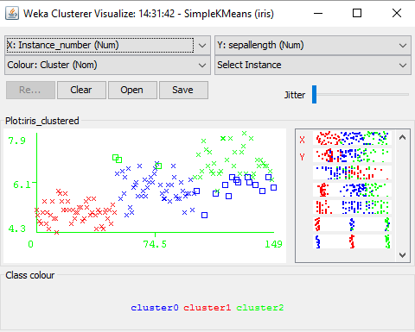
Appendix B – WEKA Clustering: Explorer Results
1
After running the algorithm, we can see the results in the “Clusterer output.”
We can also visualize the clusters by right clicking on the model in the left corner and selecting visualize.

Slide 35
Appendix C – WEKA Integration with Java
WEKA can be imported using a Java library to your own Java application.
There are three sets of classes you may need to use when developing your own application.
Classes for Loading Data
Classes for Classifiers
Classes for Evaluation

Slide 36
Appendix C – WEKA Integration with Java – Loading Data
Related WEKA classes
weka.core.Instances
weka.core.Instance
weka.core.Attribute
How to load input data file into instances?
Every DataRow -> Instance, Every Attribute -> Attribute, Whole -> Instances
# Load a file as Instances
FileReader reader;
reader = new FileReader(path);
Instances instances = new Instances(reader);

Slide 37
Appendix C – WEKA Integration with Java – Loading Data
Instances contain Attribute and Instance
How to get every Instance within the Instances?
How to get an Attribute?
# Get Instance
Instance instance = instances.instance(index);
# Get Instance Count
int count = instances.numInstances();
# Get Attribute Name
Attribute attribute = instances.attribute(index);
# Get Attribute Count
int count = instances.numAttributes();

Slide 38
Appendix C – WEKA Integration with Java – Loading Data
How to get the Attribute value of each Instance?
Class Index (Very Important!)
# Get value
instance.value(index); or
instance.value(attrName);
# Get Class Index
instances.classIndex(); or
instances.classAttribute().index();
# Set Class Index
instances.setClass(attribute); or
instances.setClassIndex(index);

Slide 39
Appendix C – WEKA Integration with Java - Classifiers
WEKA classes for C4.5, Naïve Bayes, and SVM
Classifier: all classes which extend weka.classifiers.Classifier
C4.5: weka.classifier.trees.J48
NaiveBayes: weka.classifiers.bayes.NaiveBayes
SVM: weka.classifiers.functions.SMO
How to build a classifier?
# Build a C4.5 Classifier
Classifier c = new weka.classifier.trees.J48();
c.buildClassifier(trainingInstances);
# Build a SVM Classifier
Classifier e = weka.classifiers.functions.SMO();
e.buildClassifier(trainingInstances);

Slide 40
Appendix C – WEKA Integration with Java - Evaluation
Related WEKA classes for evaluation:
weka.classifiers.CostMatrix
weka.classifiers.Evaluation
How to use the evaluation classes?
# Use Classifier To Do Classification
CostMatrix costMatrix = null;
Evaluation eval = new Evaluation(testingInstances, costMatrix);
for (int i = 0; i < testingInstances.numInstances(); i++){
eval.evaluateModelOnceAndRecordPrediction(c,testingInstances.instance(i));
System.out.println(eval.toSummaryString(false));
System.out.println(eval.toClassDetailsString()) ;
System.out.println(eval.toMatrixString());
}

Slide 41
Appendix C – WEKA Integration with Java – Evaluation
How to obtain the training dataset and the testing dataset?
Random random = new Random(seed);
instances.randomize(random);
instances.stratify(N);
for (int i = 0; i < N; i++)
{
Instances train = instances.trainCV(N, i , random);
Instances test = instances.testCV(N, i , random);
}

Slide 42
BIG DATA MINING TOOLS: MAHOUT AND MLLIB

Slide 43
Mahout
While WEKA can be run in Big Data environments, Mahout and Spark are more commonly used for Big Data applications:
Mahout is a scalable data mining engine on Hadoop (and other clusters).
“Weka on Hadoop Cluster”.
Steps:
1) Prepare the input data on HDFS.
2) Run a data mining algorithm using Mahout on the master node.

Slide 44
Spark Components – MLlib
Spark, typically installed on Hadoop, contains a distributed machine learning framework called MLlib (Machine Learning Library).
Spark MLlib is nine times as fast as the Hadoop disk-based version of Apache Mahout (before Mahout gained a Spark interface).
Spark MLlib provides a variety of classic machine learning algorithms.

Slide 45
Mahout vs MLlib: Major Algorithm Coverage
 | Mahout | MLlib
Regression | N/A | Linear Regression, Isotonic Regression, Survival Analysis
Classification | Logistic Regression, Naïve Bayes, Random Forest, Hidden Markov Models, Multilayer Perceptron | Logistic Regression, Naïve Bayes, linear Support Vector Machine, Decision Tree, Random Forest, Multilayer Perceptron
Clustering | K-Means, Spectral Clustering | K-Means, Spectral Clustering, Gaussian Mixtures
Dimension Reduction | Singular Value Decomposition, Principal Component Analysis, QR Decomposition | Singular Value Decomposition, Principal Component Analysis, QR Decomposition, Elastic Net
Text Mining | Latent Dirichlet Allocation, TF-IDF, Collocations | Latent Dirichlet Allocation, TF-IDF, Word2Vec, Tokenization
Recommendation | Alternating Least Squares | Alternating Least Squares, Association Rule Mining, FP-Growth
Notes:
details and comparison with Mahout and MLlib, including: algorithms coverage, input/output (e.g., disks, files, visualization), other APIs options, strengths/weaknesses (e.g., parallel training, speed up), etc. Please include3 1-2 examples for each.

Slide 46
Mahout vs MLlib: Input/Output
 | Mahout | MLlib
Input | -Text files -Lucene/Solr -Relational Databases (MySQL, SQL Server, Oracle) -Hadoop (HDFS, Cassandra, Hbase, MongoDB) | -Text files (Local, Remote); JSON -Relational Databases (MySQL, SQL Server, Oracle) -Hadoop (HDFS, Parquet, Cassandra, Hbase, Hive, Amazon S3)
Output | -Trained Model in Mahout Format -Evaluation Metrics -Text Files | -Predictive Model Markup Language -Evaluation Metrics -Text files (Local, Remote); JSON Relational Databases (MySQL, SQL Server, Oracle) -Hadoop (HDFS, Parquet, Cassandra, Hbase, Hive, Amazon S3)
Visualization | -Only clustering results | -N/A
Neither tool is good at visualization. However, their output can be loaded into other software for visualization purposes (e.g., Zeppelin, Tableau, etc.)
Notes:
details and comparison with Mahout and MLlib, including: algorithms coverage, input/output (e.g., disks, files, visualization), other APIs options, strengths/weaknesses (e.g., parallel training, speed up), etc. Please include3 1-2 examples for each.

Slide 47
Mahout vs MLlib: Pros and Cons
 | Mahout | MLlib
Pros | -Based on Hadoop & MapReduce | -Scalability -Performance -User-friendly API’s -Integration with SparkSQL, Streaming & GraphX
Cons | -Low efficiency on iterative algorithms -Limited coverage of algorithms | -Configurability -Reliability -High-memory consumption
Mahout is gradually being replaced by MLlib, because MLlib runs faster on iterative tasks and has greater algorithm coverage.
As such, Mahout is redirecting towards building a fundamental math environment for creating scalable machine learning applications.
Notes:
details and comparison with Mahout and MLlib, including: algorithms coverage, input/output (e.g., disks, files, visualization), other APIs options, strengths/weaknesses (e.g., parallel training, speed up), etc. Please include3 1-2 examples for each.

Slide 48
Mahout Example: Naïve Bayes
This example demonstrates the application of Naïve Bayes to classifying news into 20 news topics.
Dataset: http://people.csail.mit.edu/jrennie/20Newsgroups/20news-bydate.tar.gz
Step 1. Preprocessing (converting texts into vectors)
mahout seqdirectory
-i ${WORK_DIR}/20news-all
-o ${WORK_DIR}/20news-seq
mahout seq2sparse
-i ${WORK_DIR}/20news-seq
-o ${WORK_DIR}/20news-vectors
-wt tfidf

Slide 49
Mahout Example: Naïve Bayes
Step 1. Preprocessing Continued (splitting the dataset into training sets and testing sets)
mahout split
-i ${WORK_DIR}/20news-vectors/tfidf-vectors
--trainingOutput ${WORK_DIR}/20news-train-vectors
--testOutput ${WORK_DIR}/20news-test-vectors
--randomSelectionPct 40
--overwrite --sequenceFiles -xm sequential
Step 2. Train the classifier
mahout trainnb
-i ${WORK_DIR}/20news-train-vectors
-o ${WORK_DIR}/model
-li ${WORK_DIR}/labelindex

Slide 50
Mahout Example: Naïve Bayes
Step 3. Test the classifier
mahout testnb
-i ${WORK_DIR}/20news-test-vectors
-m ${WORK_DIR}/model
-l ${WORK_DIR}/labelindex
-o ${WORK_DIR}/20news-testing
Output:
Confusion Matrix
Statistics including: Kappa, Accuracy, Reliability

Slide 51
Mahout Example: Random Forest
This example demonstrates the application of Random Forest to NSL-KDD dataset.
Dataset: http://nsl.cs.unb.ca/NSL-KDD/
Step 1. Generating the descriptor file
hadoop jar $MAHOUT_HOME/core/target/mahout-core-xyz.job.jar org.apache.mahout.classifier.df.tools.Describe -p /user/hue/KDDTrain/KDDTrain+_20Percent.arff -f /user/hue/KDDTrain/KDDTrain+.info -d N 3 C 2 N C 4 N C 8 N 2 C 19 N L
N 3 C 2 N C 4 N C 8 N 2 C 19 N L defines that the dataset is starting with a numeric (N), followed by three categorical attributes, and so on. In the last, L defines the label.
path for the data to be described.
location for the generated descriptor file.
the information for the attribute on the data

Slide 52
Mahout Example: Random Forest
Step 2. Building the Random forest
hadoop jar $MAHOUT_HOME/examples/target/mahout-examples-xyz-job.jar org.apache.mahout.classifier.df.mapreduce.BuildForest -Dmapred.max.split.size=1874231 -d /user/hue/KDDTrain/KDDTrain+_20Percent.arff -ds /user/hue/KDDTrain/KDDTrain+.info -sl 5 -p -t 100 –o /user/hue/ nsl-forest
Dmapred.max.split.size indicates to Hadoop the maximum size of each partition.
d stands for the data path.
ds stands for the location of the descriptor file.
sl is a variable to select randomly at each tree node. Here, each tree is built using five randomly selected attributes per node.
p uses partial data implementation.
t stands for the number of trees to grow. Here, the commands build 100 trees using partial implementation.
o stands for the output path that will contain the decision forest.

Slide 53
Mahout Example: Random Forest
Step 3. Testing
hadoop jar $MAHOUT_HOME/examples/target/mahout-examples-xyz-job.jar org.apache.mahout.classifier.df.mapreduce.TestForest -i /user/hue/KDDTest/KDDTest+.arff -ds /user/hue/KDDTrain/KDDTrain+.info -m /user/hue/nsl-forest -a –mr -o /user/hue/predictions
I indicates the path for the test data
ds stands for the location of the descriptor file
m stands for the location of the generated forest from the previous command
a informs to run the analyzer to compute the confusion matrix
mr informs Hadoop to distribute the classification
o stands for the location to store the predictions in
Output:
Confusion Matrix
Statistics including: Kappa, Accuracy, Reliability

Slide 54
MLlib Example (in Python): Naïve Bayes
Step 1. Preprocessing (loading data and splitting training/testing sets)
data = sc.textFile([PATH TO DATA]).map(parseLine)
training, test = data.randomSplit([0.6, 0.4], seed=0)
Step 2. Training the model
model = NaiveBayes.train(training, 1.0)
Step 3. Testing the model
predictionAndLabel = test.map(lambda p: (model.predict(p.features), p.label))
accuracy = 1.0 * predictionAndLabel.filter(lambda (x, v): x == v).count() / test.count()
Output:
Accuracy (other metrics can be developed accordingly)

Slide 55
MLlib Example (in Python): Random Forest
Step 1. Preprocessing (loading data and splitting training/testing sets)
data = MLUtils.loadLibSVMFile(sc, [PATH TO DATA])
(trainingData, testData) = data.randomSplit([0.7, 0.3])
Step 2. Training the model (binary classification, 3 trees, max depth is 4 and max number of bins is 32)
model = RandomForest.trainClassifier(trainingData, numClasses=2, categoricalFeaturesInfo={}, numTrees=3, featureSubsetStrategy="auto", impurity='gini', maxDepth=4, maxBins=32)
Step 3. Testing the model
predictions = model.predict(testData.map(lambda x: x.features))
labelsAndPredictions = testData.map(lambda lp: lp.label).zip(predictions)
testErr = labelsAndPredictions.filter(lambda (v, p): v != p).count() / float(testData.count())
Output:
Testing Error (other metrics can be developed accordingly)

